Slide 1
Naan mudhalvan assignment
By,
B.keerthana
(921420108015)
Rvsetgi, Dindigul

Slide 2
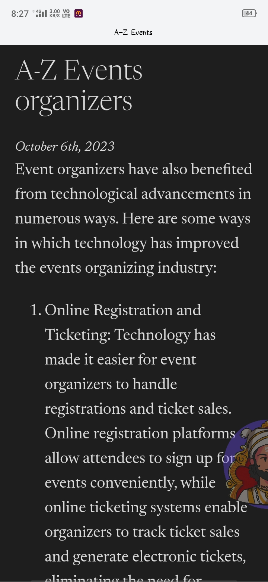
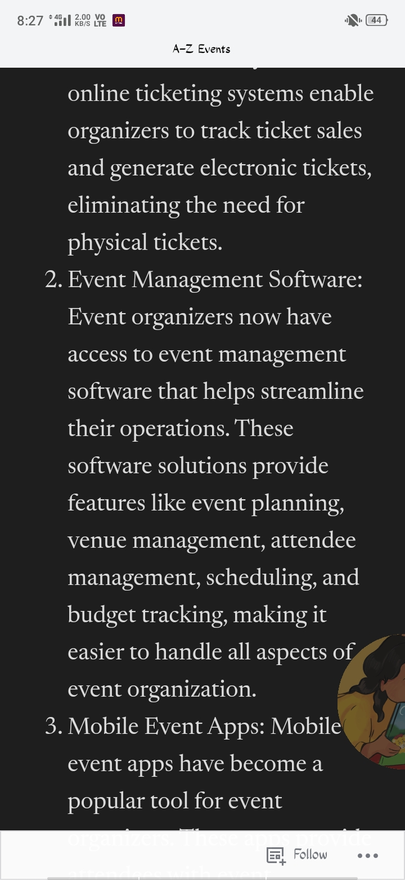
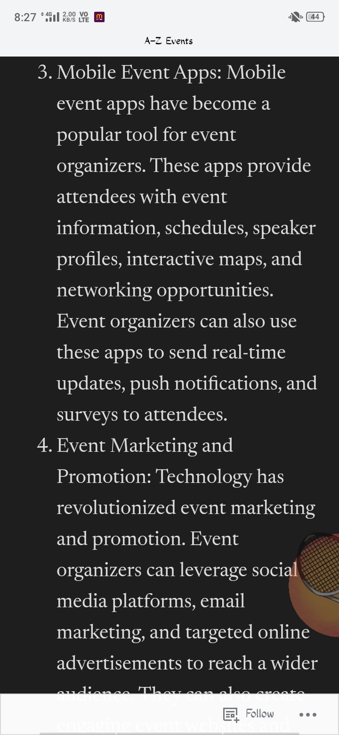
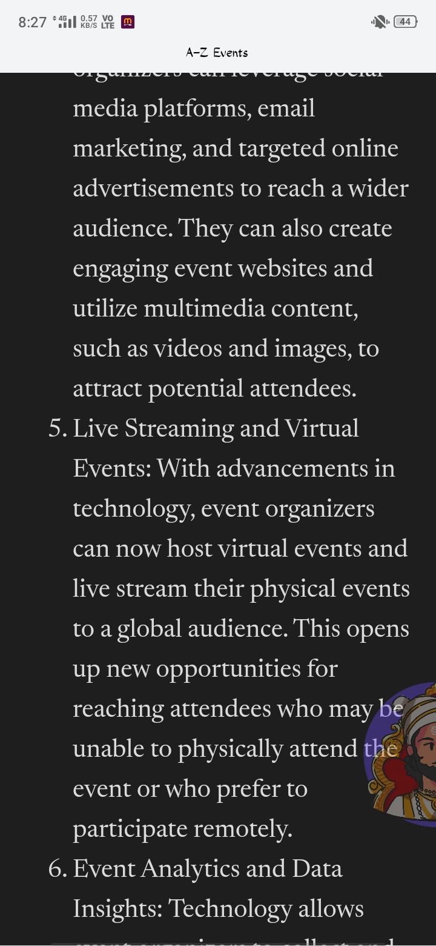
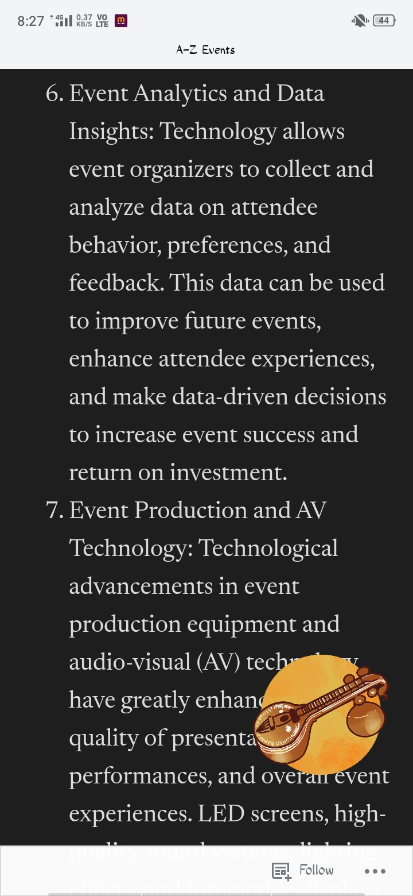
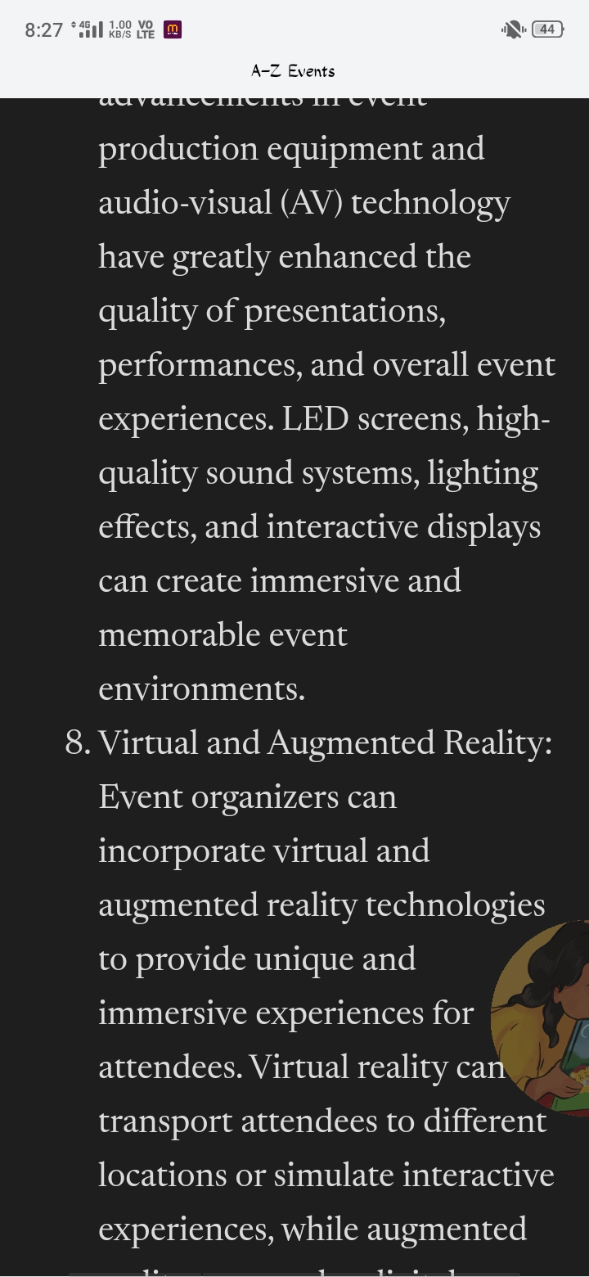
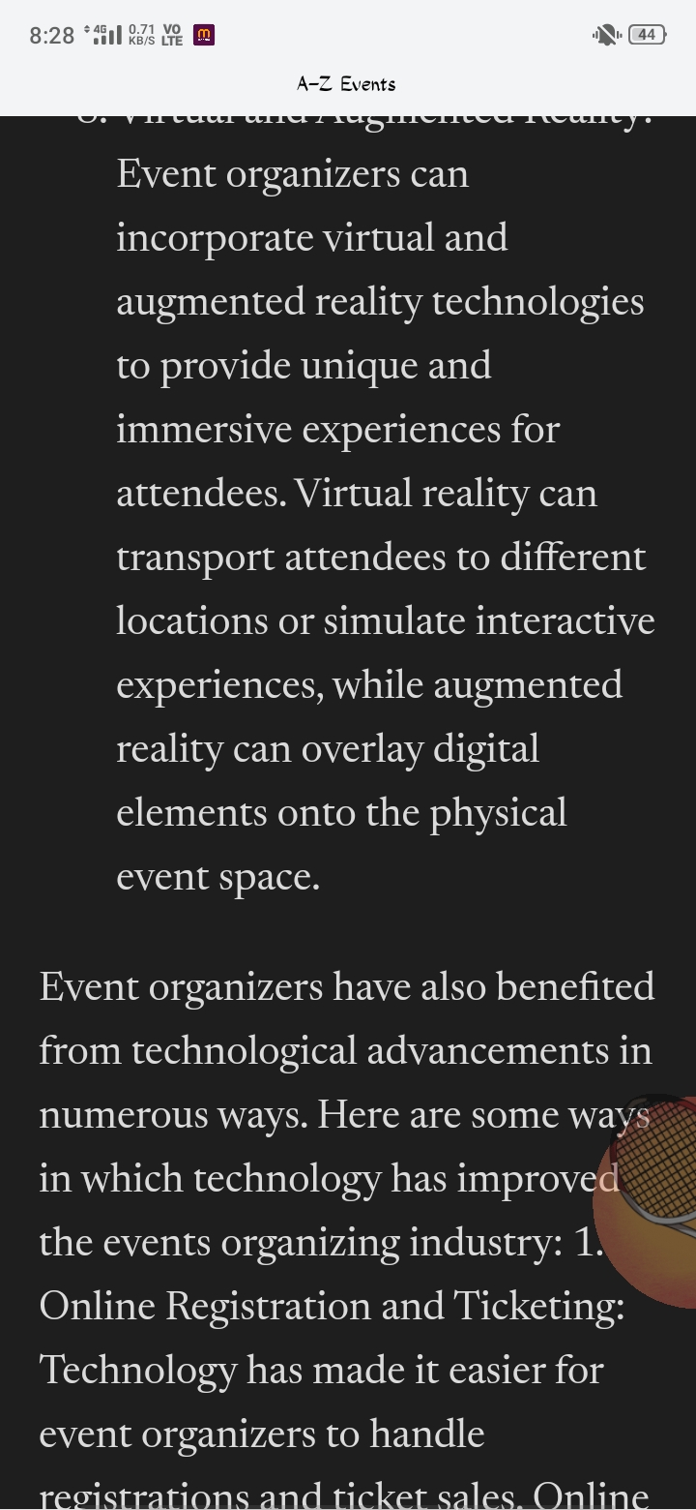
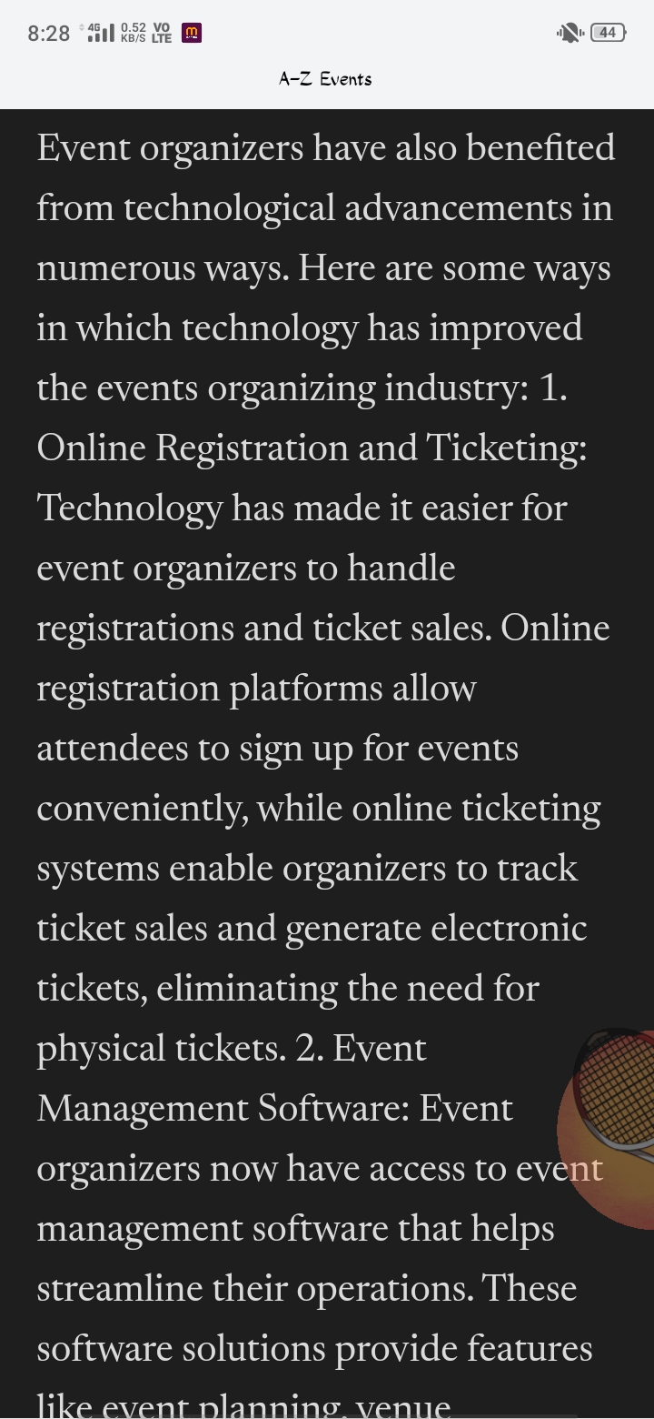
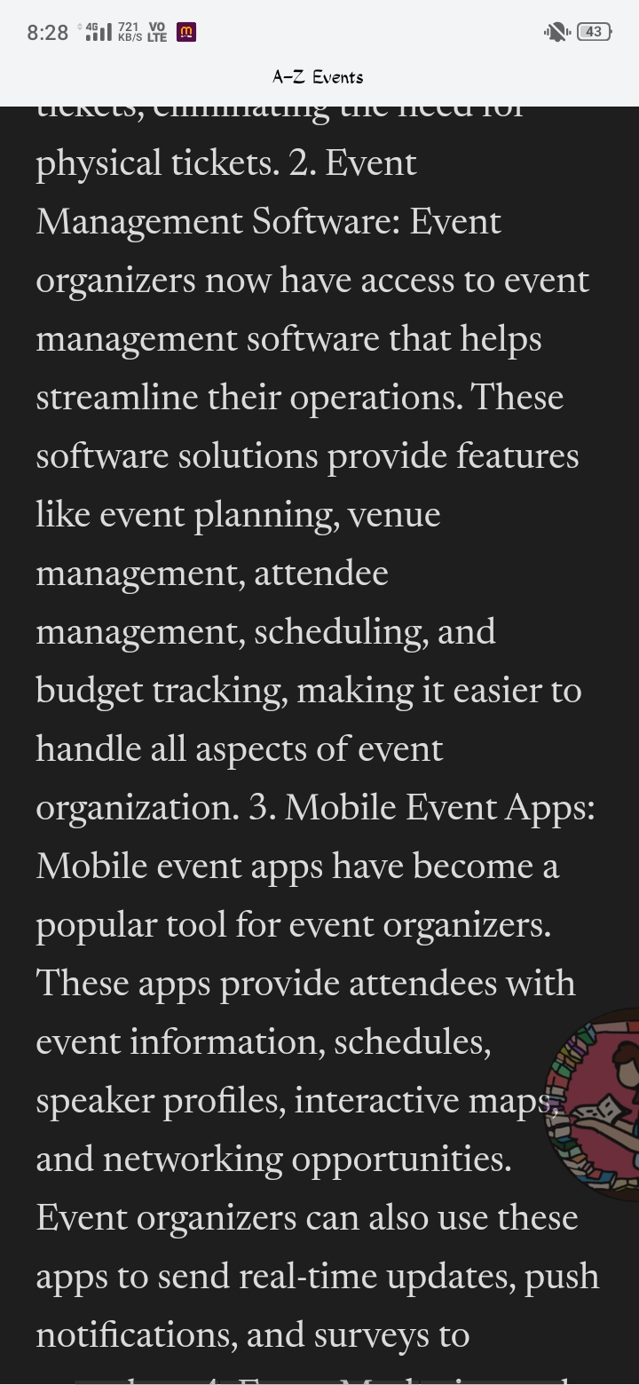
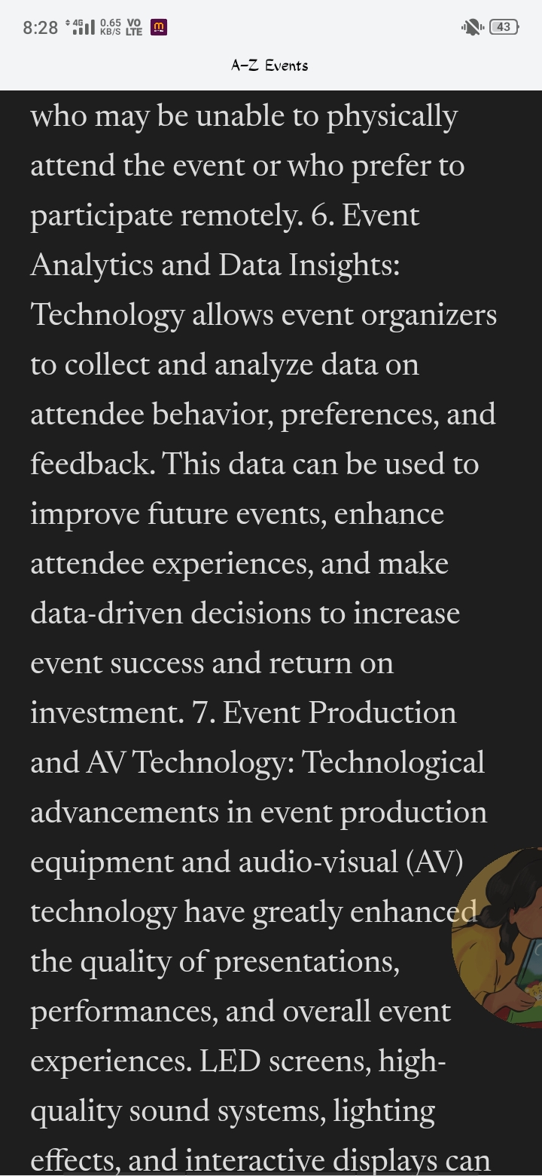
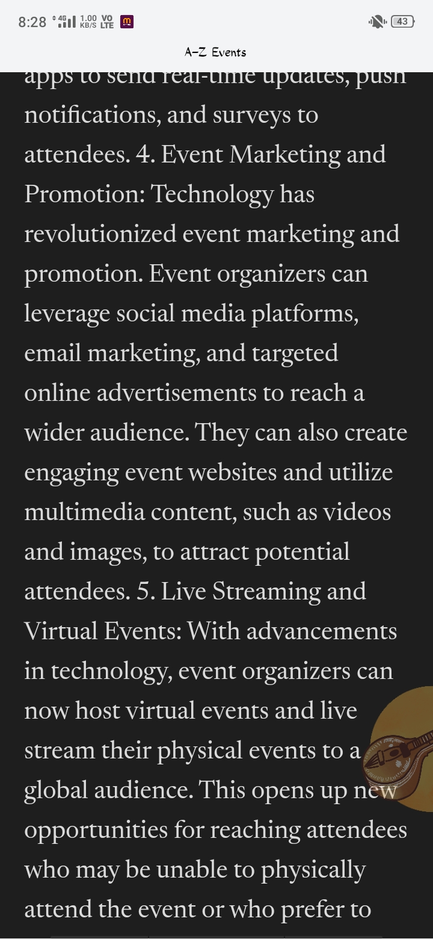
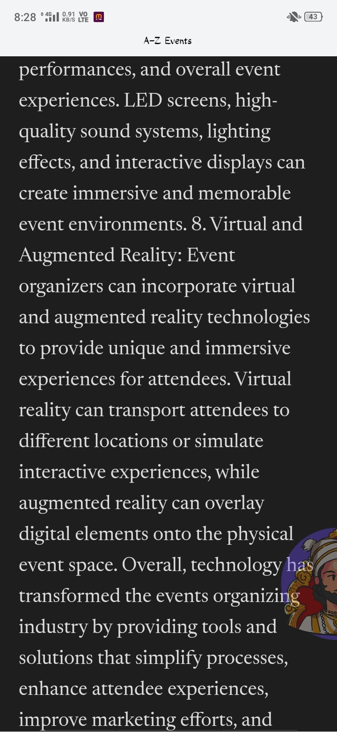
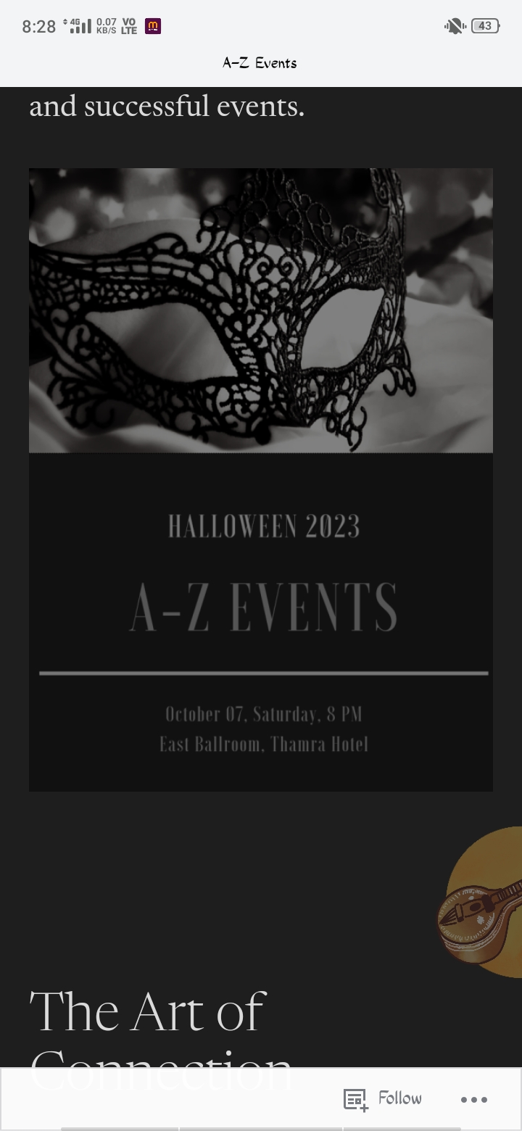
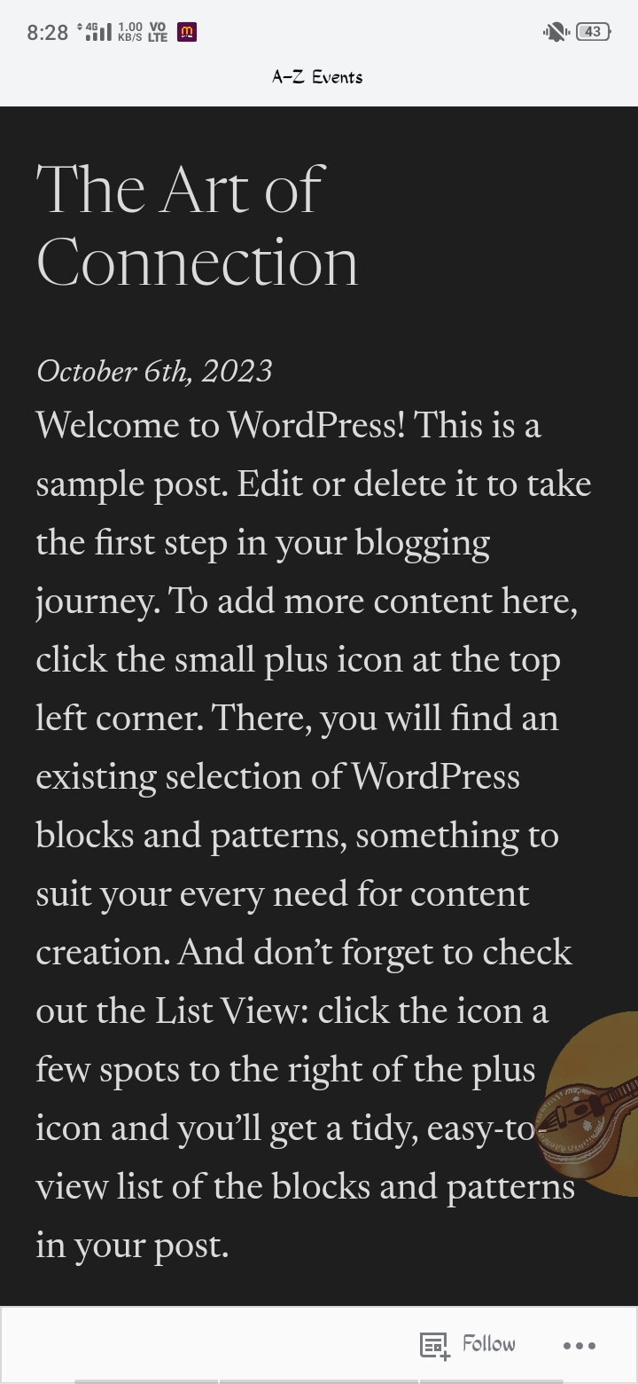
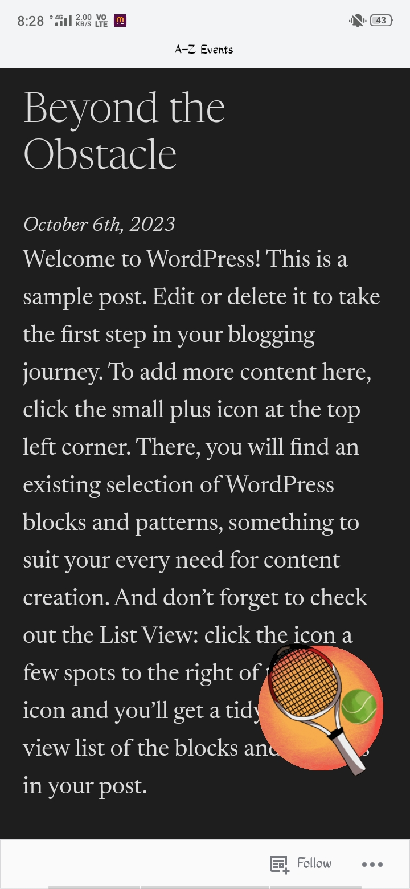
Creat a blog or website using blogspot and WordPress.customize the theme design and post new article with 500 words
https://keerthanakodai20037.wordpress.com/
Notes:
https://keerthanakodai20037.wordpress.com/

Slide 3
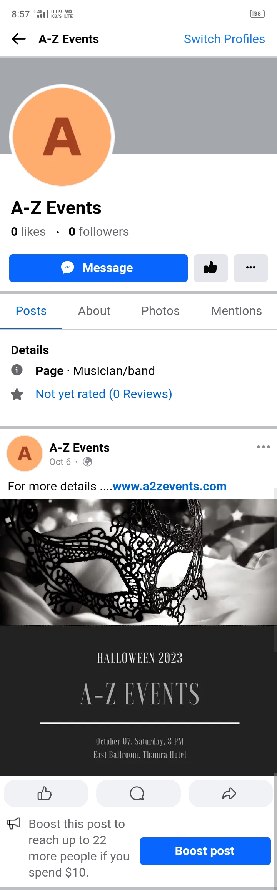
2.Create a new Facebook business page and post one social media poster for your brand
https://m.facebook.com/profile.php/?id=61551775456465

Slide 4


3.Create and design a social media advertisement poster using canva
https://www.canva.com/design/DAFwfdExJ_8/mjFodBMXX8daakgwJJCWow/view?utm_content=DAFwfdExJ_8&utm_campaign=share_your_design&utm_medium=link&utm_source=shareyourdesignpanel

Slide 5
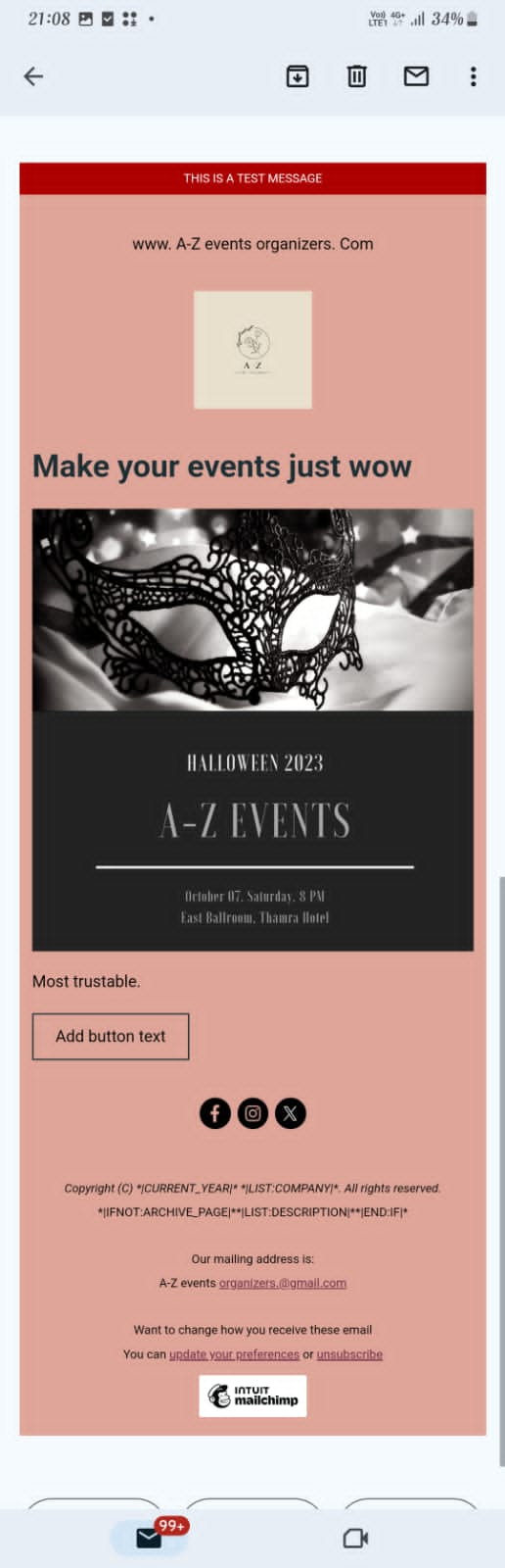
Create a news design using MailChimp or canva tool

